Slide 1
Applied Machine Learning SEZG568/SSZG568
Dr Y V K RAVI KUMAR
yvk.ravikumar@pilani.bits-pilani.ac.in

Slide 2
Session –8 (16th September,2023)
SUPPORT VECTOR MACHINES & Revision

Slide 3
Support Vector Machine
Support Vector Machine or SVM is one of the most popular Supervised Learning algorithms, which is used for Classification as well as Regression problems. However, primarily, it is used for Classification problems in Machine Learning.
The goal of the SVM algorithm is to create the best line or decision boundary that can segregate n-dimensional space into classes so that we can easily put the new data point in the correct category in the future. This best decision boundary is called a hyperplane.

Slide 4
What is Support Vector Machine?
The objective of the support vector machine algorithm is to find hyperplane in an N-dimensional space (N—the number of features) that distinctly classifies the data points.
To separate the two classes of data points, there are many possible hyperplanes that could be chosen.
Our objective is to find a plane that has the maximum margin, i.e the maximum distance between data points of both classes. Maximizing the margin distance provides some reinforcement so that future data points can be classified with more confidence.

Slide 5
Support vectors are data points that are closer to the hyperplane and influence the position and orientation of the hyperplane. Using these support vectors, we maximize the margin of the classifier.
Deleting the support vectors will change the position of the hyperplane. These are the points that help us build our SVM.

Slide 6
Support Vectors − Datapoints that are closest to the hyperplane is called support vectors. Separating line will be defined with the help of these data points.
Hyperplane − As we can see in the diagram, it is a decision plane or space which is divided between a set of objects having different classes.
Margin − It may be defined as the gap between two lines on the closet data points of different classes. It can be calculated as the perpendicular distance from the line to the support vectors. Large margin is considered as a good margin and small margin is considered as a bad margin.

Slide 7
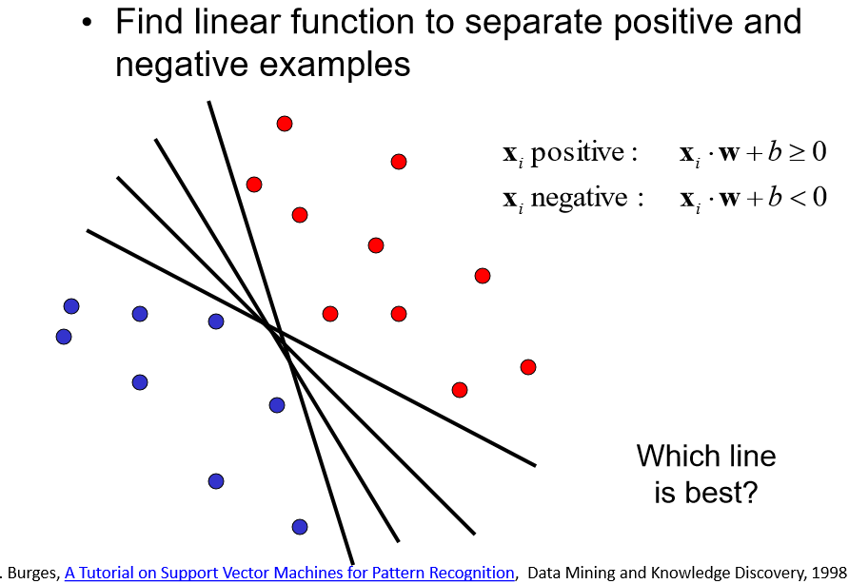
Linear Classifier

Slide 8
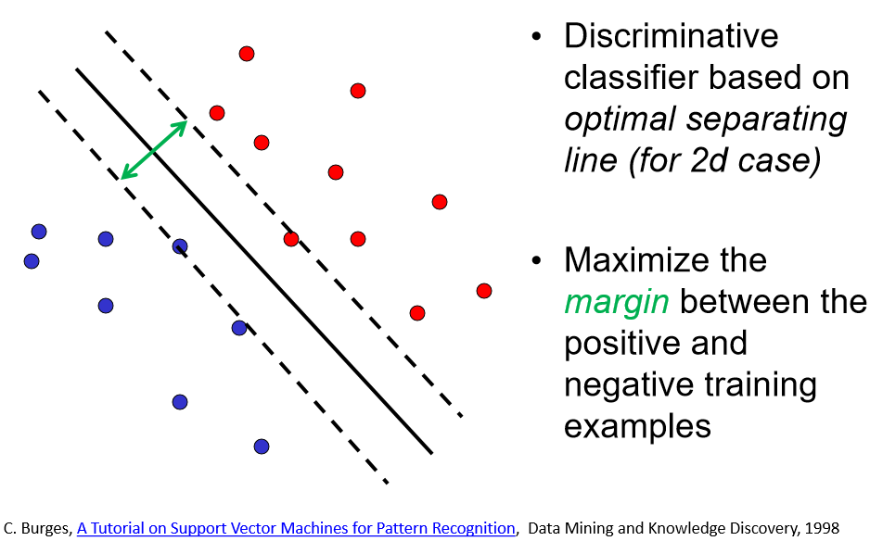

Slide 9
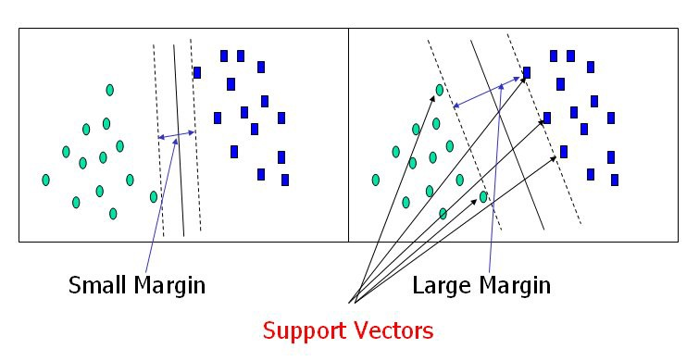

Slide 10


Slide 11
Types of SVM
SVM can be of two types:
Linear SVM: Linear SVM is used for linearly separable data, which means if a dataset can be classified into two classes by using a single straight line, then such data is termed as linearly separable data, and classifier is used called as Linear SVM classifier.
Non-linear SVM: Non-Linear SVM is used for non-linearly separated data, which means if a dataset cannot be classified by using a straight line, then such data is termed as non-linear data and classifier used is called as Non-linear SVM classifier.

Slide 12
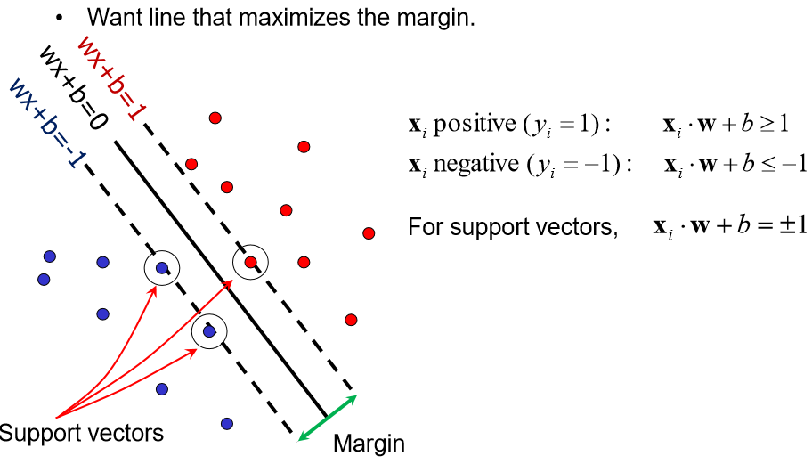
Support Vector Machines

Slide 13
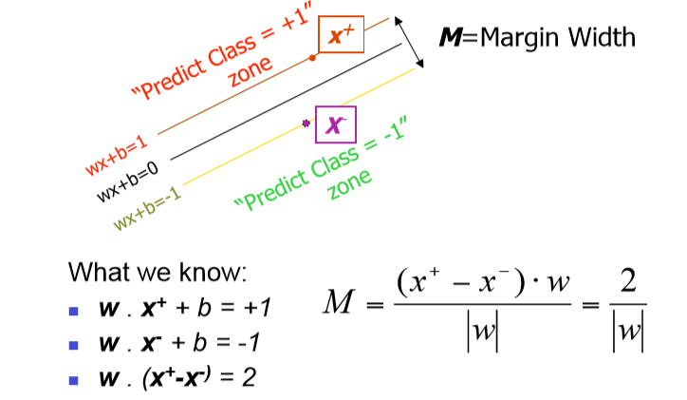
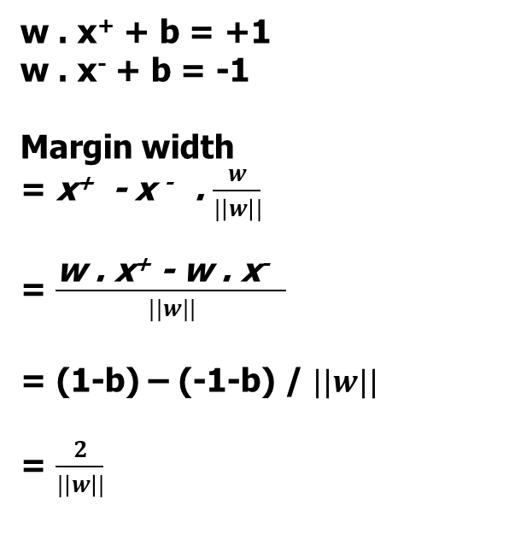
Linear SVM Mathematically
w . x⁺ + b = +1
w . x⁻ + b = -1
Margin width
= x⁺ - x ⁻ . $\frac{w}{|\left|w\right||}$
= $\frac{\text{w} \text{. }\text{x}\text{+}\text{ − }\text{w}\text{ . }\text{x}\text{−} }{||w||}$
= (1-b) – (-1-b) / $||w||$
= $\frac{2}{|\left|w\right||}$

Slide 14
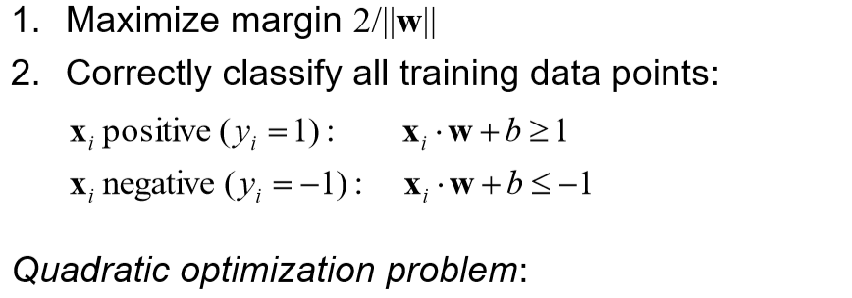
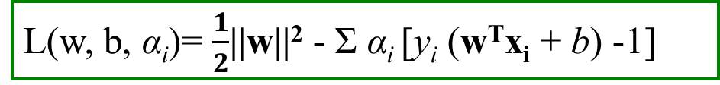
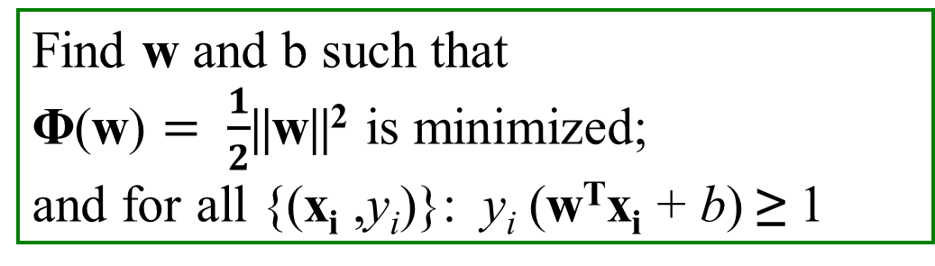
Solving the Optimization Problem
L(w, b, α_{i})= $\frac{1}{2}$||w||² - Σ α_{i} [y_{i} (w^{T}x_{i} + b) -1]
Find w and b such that
Φ(w) $= \frac{1}{2}$||w||² is minimized;
and for all {(x_{i} ,y_{i})}: y_{i} (w^{T}x_{i} + b) ≥ 1

Slide 15
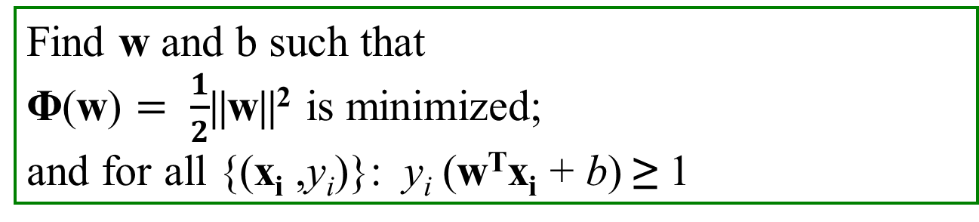
Solving the Optimization Problem
Find w and b such that
Φ(w) $= \frac{1}{2}$||w||² is minimized;
and for all {(x_{i} ,y_{i})}: y_{i} (w^{T}x_{i} + b) ≥ 1
Need to optimize a quadratic function subject to linear inequality constraints.
The solution involves constructing a dual problem where a Lagrange multiplier α_{i} is associated with every constraint in the primal problem

Slide 16
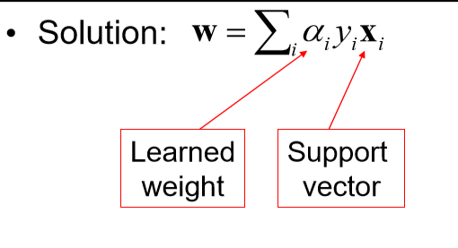
Solving the Optimization Problem

Slide 17
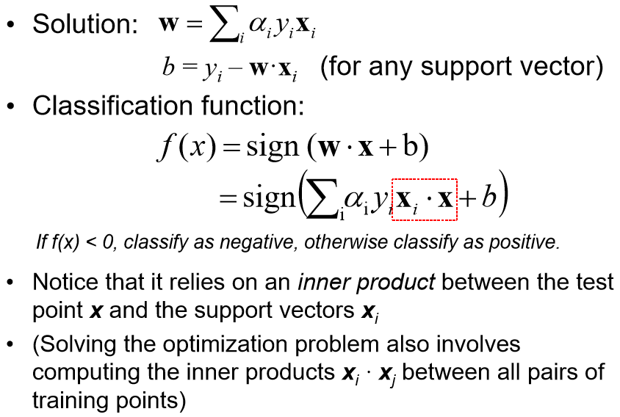
Solving the Optimization Problem

Slide 18
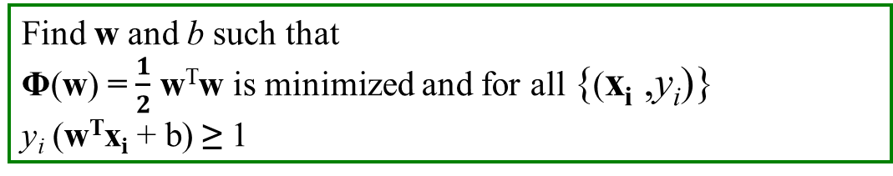
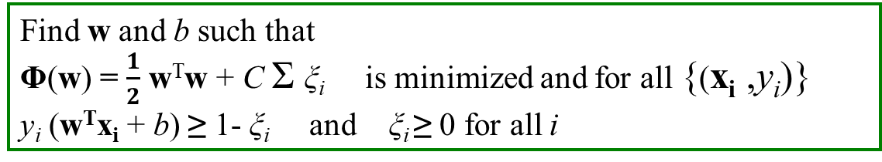
Hard Margin:
Soft Margin incorporating slack variables:
Parameter C can be viewed as a way to control overfitting.
Find w and b such that
Φ(w) = $\frac{1}{2}$ w^{T}w is minimized and for all {(x_{i} ,y_{i})}
y_{i} (w^{T}x_{i} + b) ≥ 1
Find w and b such that
Φ(w) = $\frac{1}{2}$ w^{T}w + C Σ ξ_{i} is minimized and for all {(x_{i} ,y_{i})}
y_{i} (w^{T}x_{i} + b) ≥ 1- ξ_{i} and ξ_{i} ≥ 0 for all i

Slide 19
The “Kernel Trick”
The linear classifier relies on dot product between vectors
x_{i}^{T} . x_{j}
If every data point is mapped into high-dimensional space via some transformation Φ: x → φ(x), the dot product becomes:
K(x_{i}, x_{j})= φ(x_{i})^{T} φ (x_{j})
A kernel function is some function that corresponds to an inner product in some expanded feature space.
Example:
2-dimensional vectors x=[x₁ x₂]; let K(x_{i},x_{j})=(1 + x_{i}^{T}x_{j})²,
Need to show that K(x_{i},x_{j})= φ(x_{i}) ^{T}φ(x_{j}):

Slide 20
1 | Introduction to Machine Learning: What and Why, Applications of Machine Learning, Types of Machine Learning, Challenges in Machine Learning
2 | End-to-end Machine Learning: Framing the ML Problem. Data Types, Pre-processing, Visualization and Analysis
3 | End-to-end Machine Learning: Model Selection and Training for Prediction and Classification, Evaluation, Machine Learning Pipeline.
4 | Linear Prediction Models: Linear Regression, Gradient Descent and Variants, Regularization, Bias Vs. Variance

Slide 21
5 | Classification Models I: Naïve Bayes classification, Applications in text and image classification
6 | Classification Models I: Logistic Regression, Log Loss error function, Optimization using gradient descent, Feature transformation for nonlinear classification
7 | Classification Models I: Support Vector Machine. Margin maximization. Non-linear SVM. Kernel Function.

Slide 23
Thank You!

